Slide 1

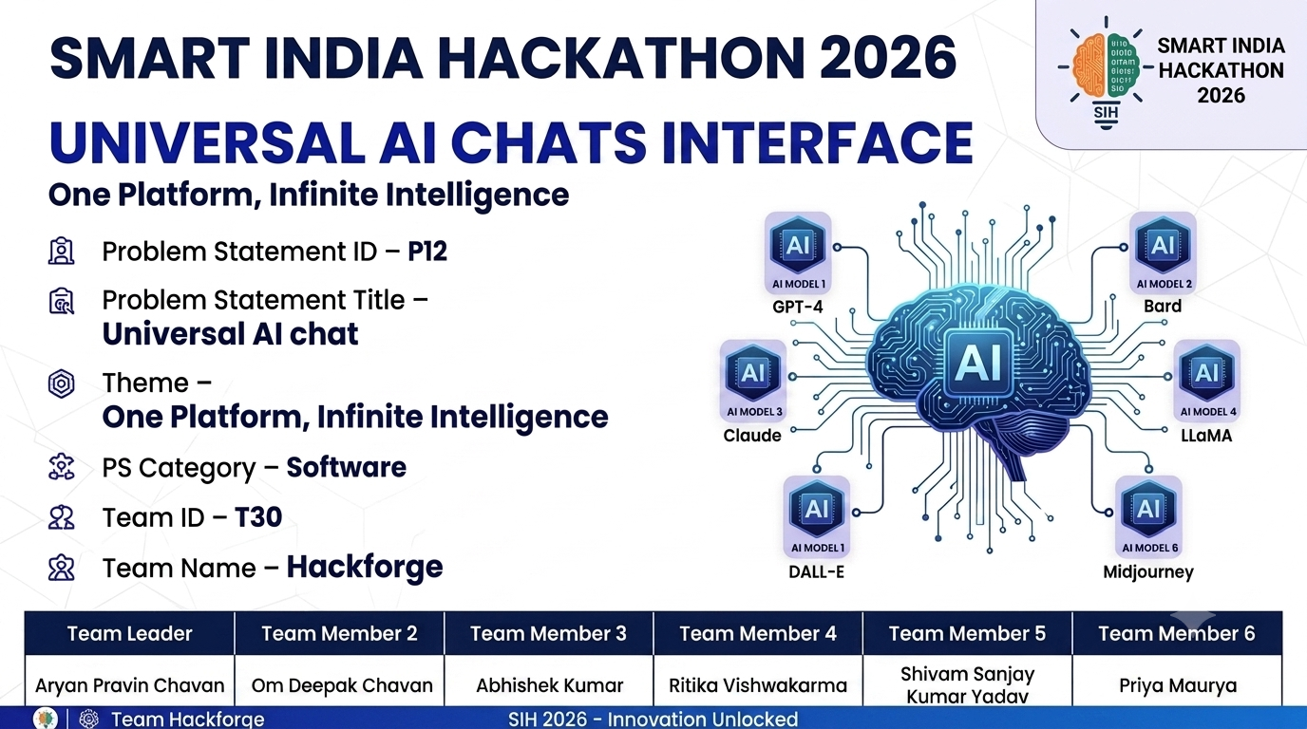

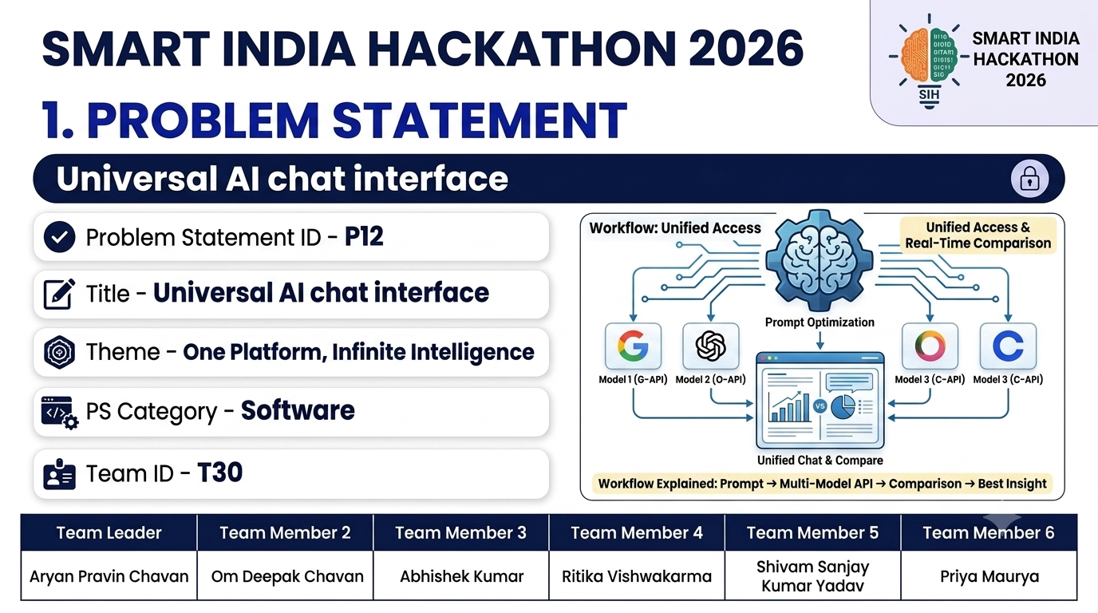

SMART INDIA HACKATHON 2026
@SIH presentation - Template
1

Slide 2
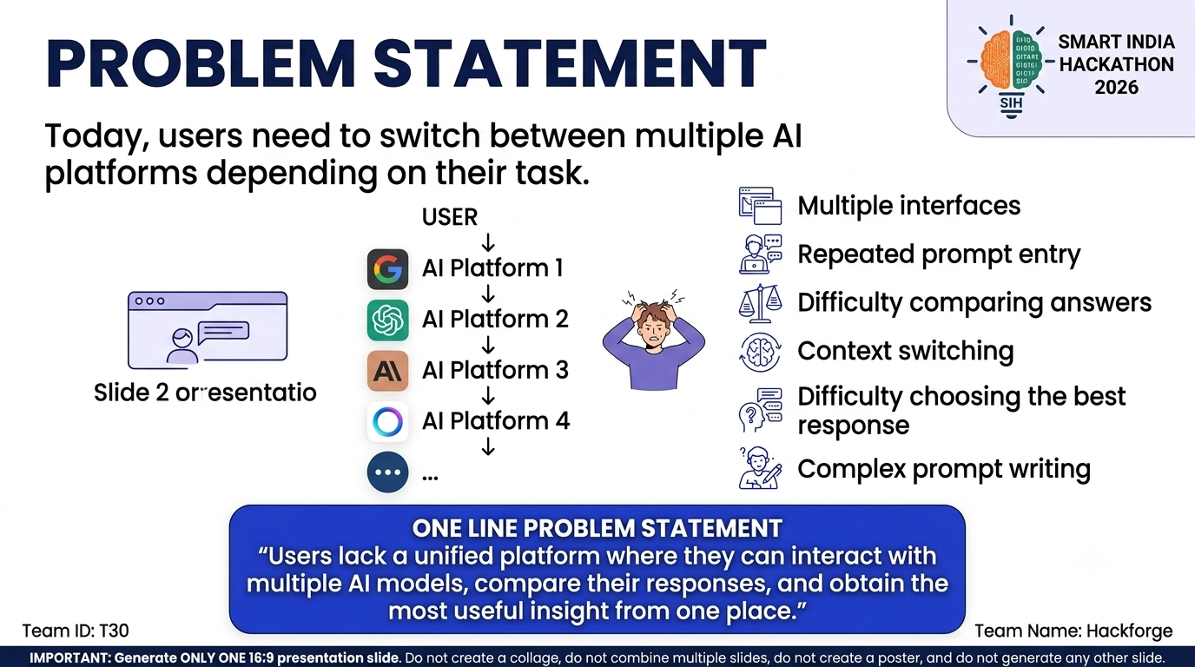
Hackforge
@SIH presentation - Template
2

Slide 3

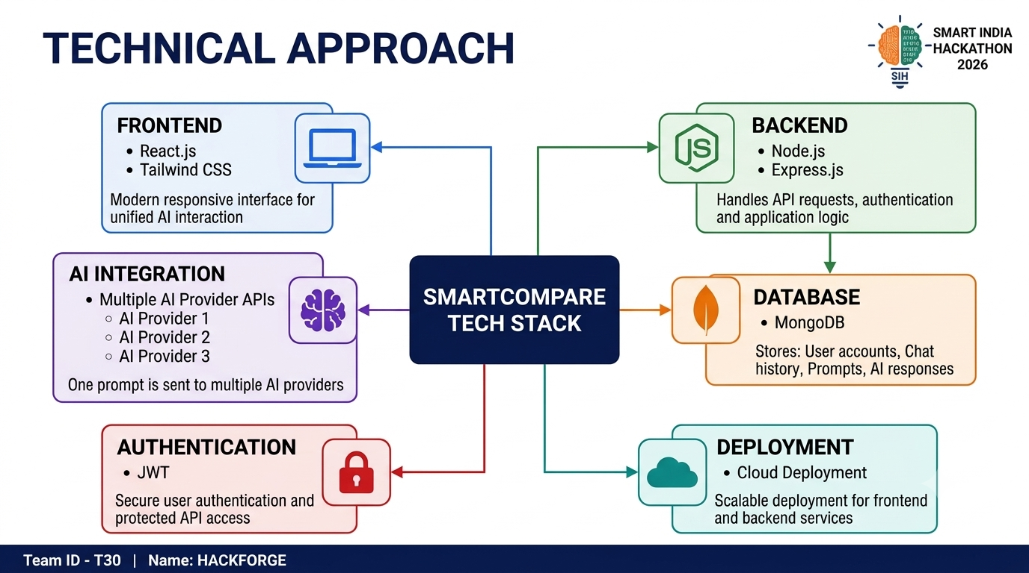

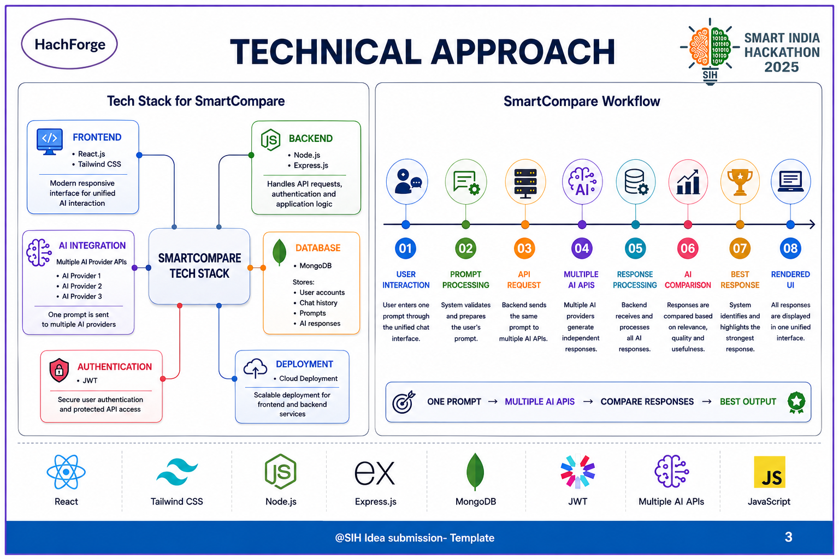
Hackforge
@SIH presentation - Template
3

Slide 4
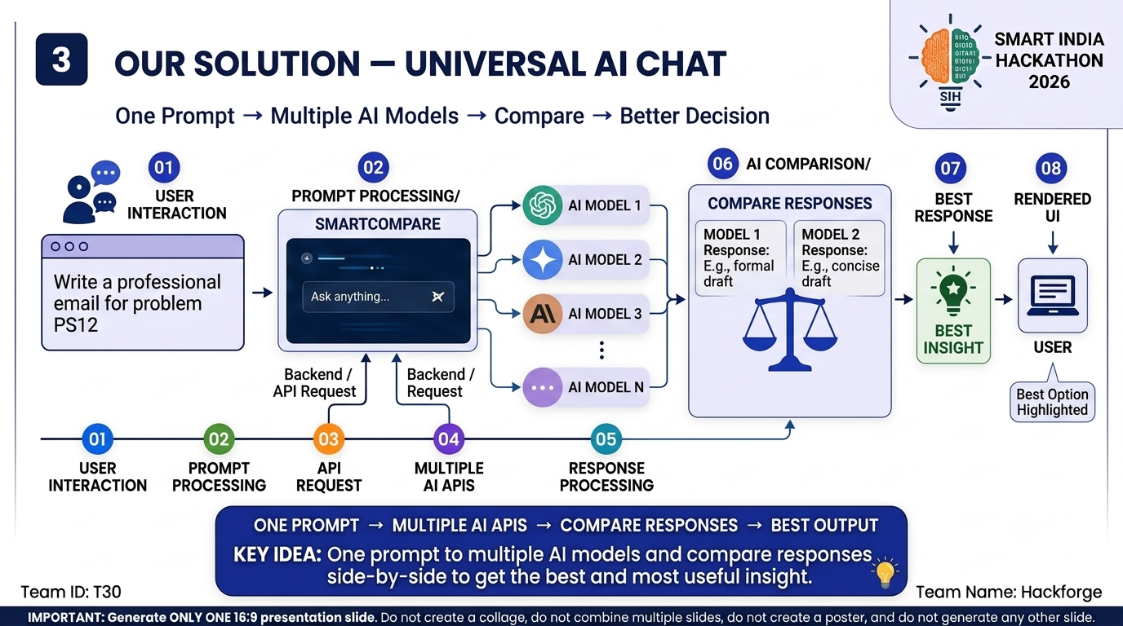
Hackforge
@SIH presentation - Template
4

Slide 5
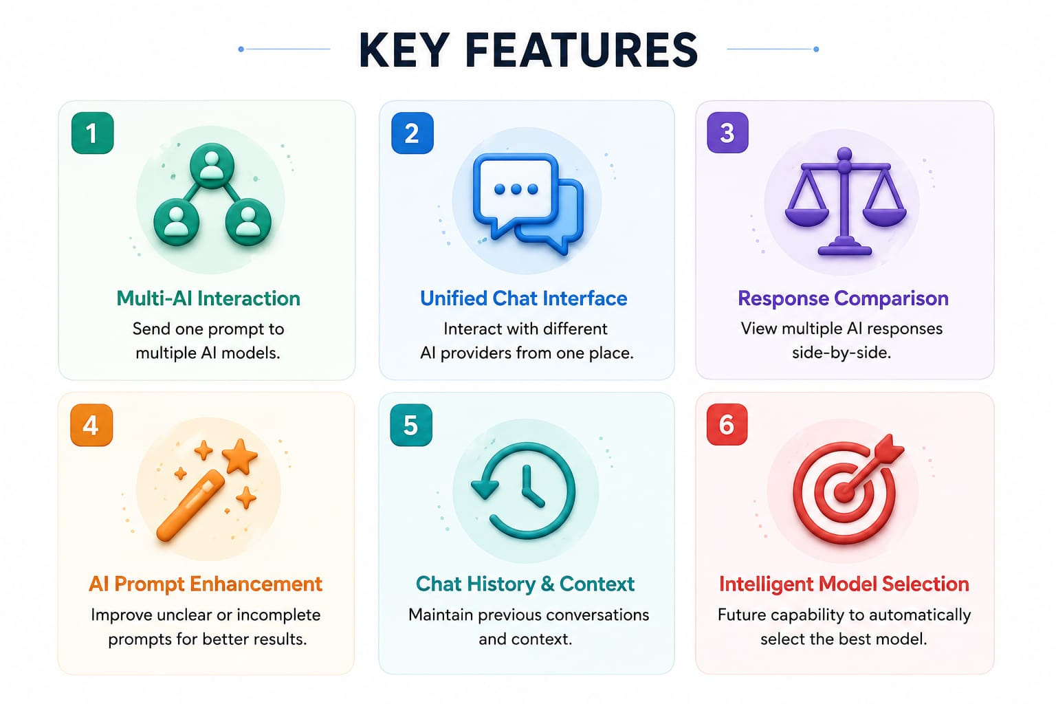
Hackforge
@SIH presentation - Template
5

Slide 6
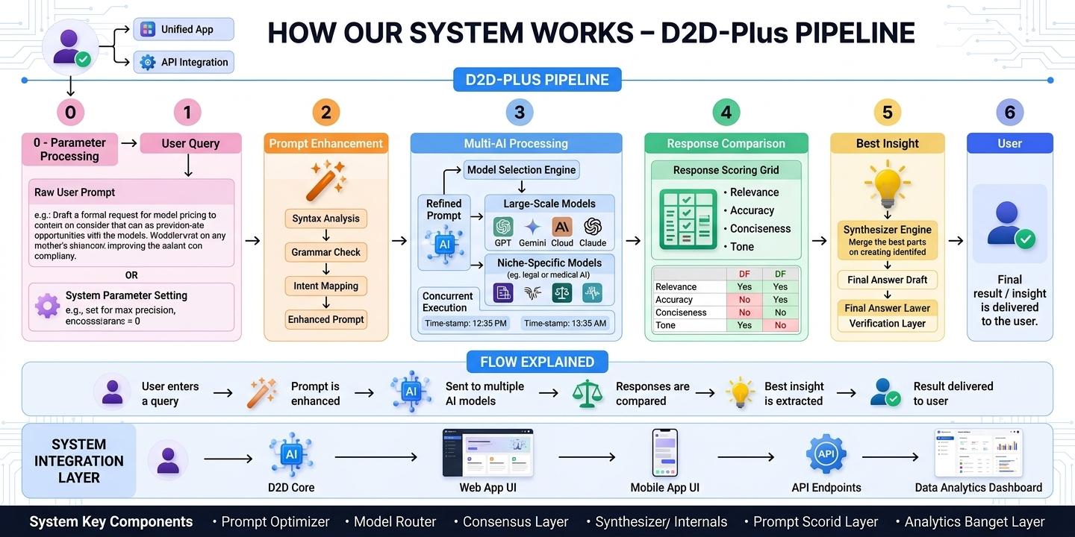
Hackforge
@SIH presentation - Template
6

Slide 7
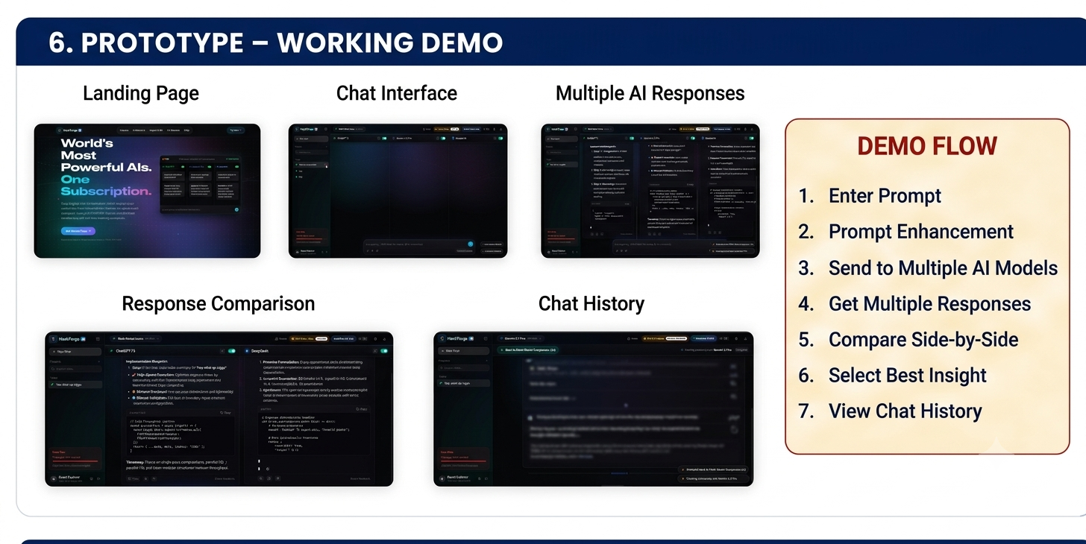
Hackforge
@SIH presentation - Template
7

Slide 8
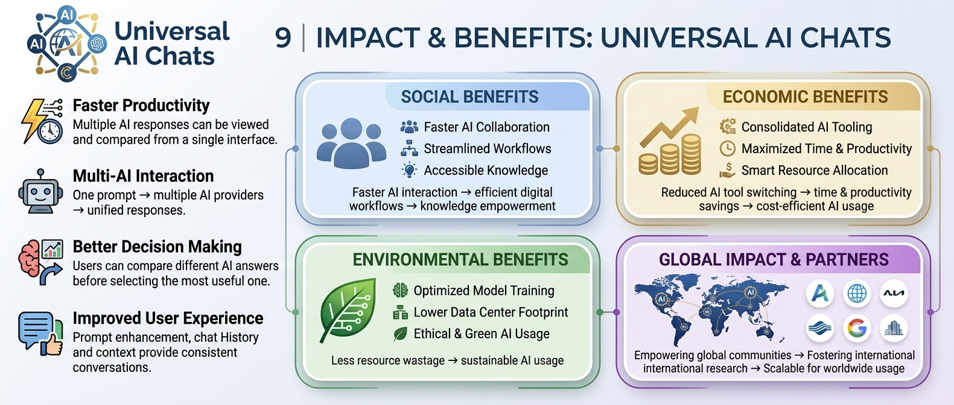
Hackforge
@SIH presentation - Template
8

Slide 9
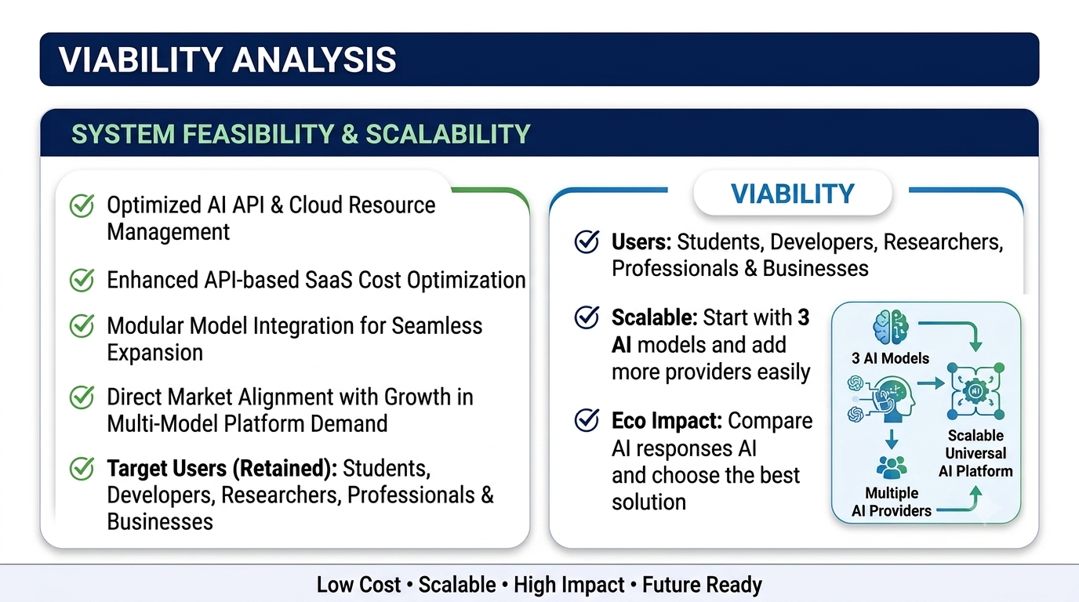
Hackforge
FEASIBILITY AND VIABILITY
@SIH presentation - Template
9

Slide 10

10

